Slide 1
Discovering and Managing Quantitative Association Rules
Chunyao Song, Tingjian Ge
University of Massachusetts, Lowell

Slide 2
Outline
Background and Motivation
Divide and Conquer Method for Mining Quantitative Association Rules
Experiments

Slide 3
From Market Basket Analysis to Quantitative Association Rules
{Diapers} →{Beer}
ID | SL | SW | PL | PW | Class
1 | 5.1 | 3.5 | 1.4 | 0.2 | Iris-setosa
2 | 5.4 | 3.9 | 1.7 | 0.4 | Iris-setosa
3 | 5 | 3.5 | 1.6 | 0.6 | Iris-setosa
4 | 5.2 | 2.7 | 3.9 | 1.4 | Iris-versicolor
5 | 5 | 2.3 | 3.3 | 1 | Iris-versicolor
6 | 6.7 | 3.1 | 4.7 | 1.5 | Iris-versicolor
7 | 7.7 | 3 | 6.1 | 2.3 | Iris-virginica
8 | 6 | 2.2 | 5 | 1.5 | Iris-virginica
9 | 6 | 3 | 4.8 | 1.8 | Iris-virginica
SL∈[5.1, 5.4] ∧PW∈[0.2, 1.4]
→PL ∈[1.4, 3.9]
Class=Iris-setosa
→SW ∈[3.5, 4]

Slide 4
Preliminary
P →Q
s(r)=2
SL∈[5.1,5.4] ∧PW∈[0.2,1.4]→PL ∈[1.4,3.9]
s(P)=3
c(r)=s(r)/s(P)=0.66

Slide 5
Outline
Background and Motivation
Divide and Conquer Method for Mining Quantitative Association Rules
Experiments

Slide 6
Phase 1: get coarse rules
high
low
For each numerical attribute, partition the attribute into c buckets, then get c(c+1)/2 items

Slide 7
Phase 1: get coarse rules
Map tuple to transaction
A([0,9]) | B([12,24]) | C([3.5,8])
4 | 20 | 6.4
A | [0,3] | (3,6] | (6,9] | [0,6] | [3,9] | [0,9]
B | [12,16] | (16,20] | (20,24] | [12,20] | [16,24] | [12,24]
C | [3.5,5] | (5,6.5] | (6.5,8] | [3.5,6.5] | [5.8] | [3.5,8]
(3,6] | [0,6] | [3,9] | [0,9] | (16,20] | [12,20] | [16,24] | [12,24] | (5,6.5] | [3.5,6.5] | [5,8] | [3.5,8]
Frequent itemset mining, support at least minsup
[3,9] | [12,24] | [3.5,6.5]
Get a coarse association rule
A∈[3,9] ∧B ∈[12,24] →C ∈[3.5,6.5]
Stack R

Slide 8
Recursively partition only outermost buckets
Pop out a rule
A∈[3,9] ∧B ∈[12,24] →C ∈[3.5,6.5]
Stack R
Check termination condition
If not terminated, partition the outermost buckets
If support ≥ minsup
A
A
Derive rules r’
B
C
B
C
Stack R
If conf ≥minconf
Output r

Slide 9
Termination condition
A
B
C
If s(r)/s(P_{trim})<minconf
P_{trim}
P_{trim}
Upper bound conf
Q_{trim}
Lower bound support
if s(r)/s(P_{trim}) < (1+δ)*s(Q_{trim})

Slide 10
Temporary table optimization
Store only attributes involved
Store core count
Don’t store tuples involved in inner buckets(core).
...
...
..
..
..
..
..

Slide 11
Outline
Background and Motivation
Divide and Conquer Method for Mining Quantitative Association Rules
Experiments

Slide 12
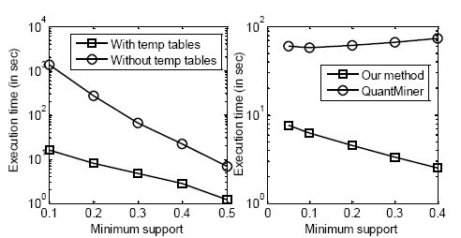
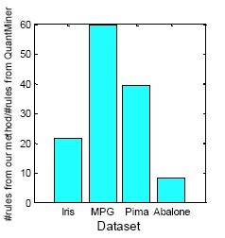
Experiments

